Slide 1
External Data Intro

Slide 2
Data – It matters
We’ve recently looked at how we can use Excel to make tools that can help us make decisions:
We can identify what we need.
Work backwards to identify the values that feed into the determination.
Build a calculation to translate those inputs into an expected output.
Try different scenarios to help forecast.
Think back to examples:
Mortgage one allows us to compare the cost details of different mortgages, to pick the best.
Racketball one allows us to try different business scenarios to estimate if we’ll make money.

Slide 3
Data and You!
Critically, we combined two things to get our end goal:
Real data (inputs and outputs) that we used to create the logic.
Our understanding of the problem, to translate reality to Excel.
We used our understanding and the tools in Excel to build an “algorithm” to create a prediction of our output from the values of our input.
An algorithm is a series of steps to accomplish a task.
We can also call our creation a “model”, something that translates inputs to outputs.
Our model will be wrong (error), but if we do a good job it can be pretty accurate.
If we collect more data (inputs and outputs), we adjust the model to match reality.

Slide 4
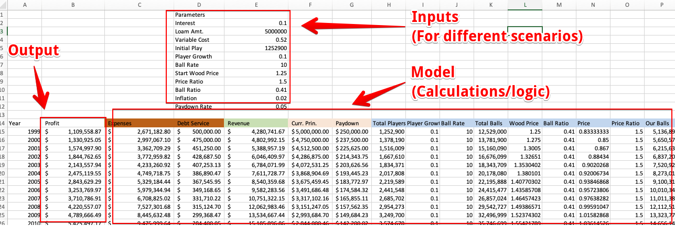
Goal - accurate prediction of outcome.
Inputs – different things that impact that outcome.
Model – the calculation that we figured out to go from A to B.

Slide 5
Decision Support Systems/Sheets
These are decision support systems.
Use our knowledge and the data we have to construct a model that will predict.
Higley dependent on how good we are at understanding the scenario.
Very common in business – budgets, ordering decisions, scheduling, etc…
Can be accurate in limited scenarios – relatively predictable situations.
Low need for data to construct one, we can use only a few examples.
In many cases we often have a reality that is very different:
A large amount of data (sales, customers, loans, tweets, etc…) on what we want to predict.
A limited understanding of how to calculate the output from the (potentially many) inputs.

Slide 6
Different Models (this is mostly context)
When dealing with those other scenarios (lots of data, hard to solve problem) we can employ other techniques to help make similar predictions.
Enter machine learning!
We provide the data - lots of examples of inputs and outputs. (Potentially millions)
The machine “learns” how to do the calculation that generates the output based on patterns in the data, we don’t need to have any idea how to go from input->output.
We can build models that do a better job of making similar predictions.
Collect data (income, location, etc…) of thousands of old loans, and if that person paid.
The computer looks at the example data, and makes a calculation to get output from input.
We have the old data, we can calculate error and then revise until we make that error lowest.

Slide 7
Large Amounts of Data (This you need to know)
This system of using old examples to make accurate predictions fits well with how data is stored in databases.
We’ll look at this in more detail over the next two times, for now we just want a basic understanding of what’s in a database.
Databases are made of tables that each look like a spreadsheet.
Each table represents an entity – one ”thing” that we track.
Each column represents an attribute - one value that we store for this entity.
Each row represents an instance – one example of that entity.
So, each table is effectively a list of items, and what we know about them.

Slide 8
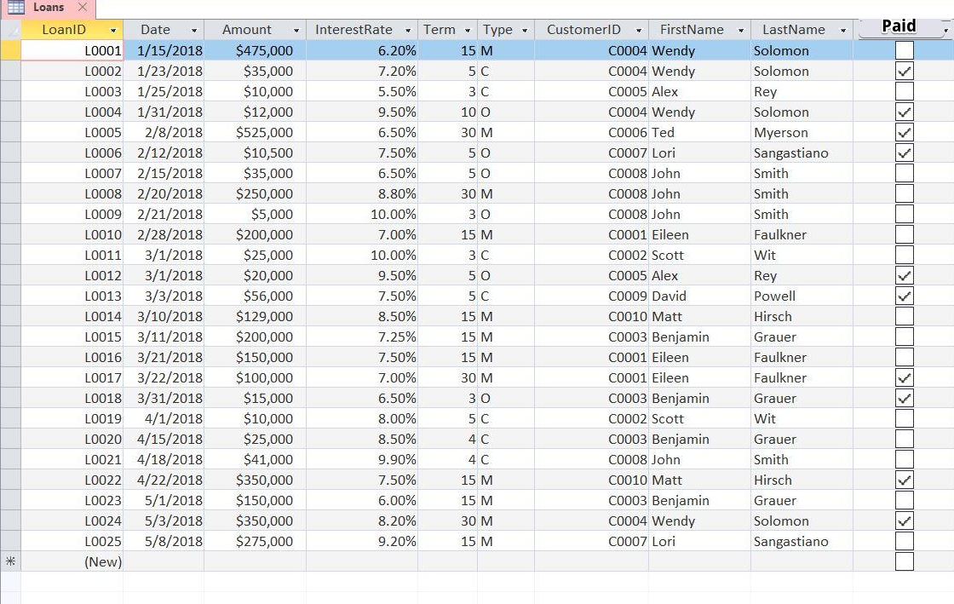
Table – loans.
Row – instance, one loan.
Column – thing we track about the loan.
Including if it was paid.
We could know the inputs (other stuff) before giving a loan, then use these old ones to predict if it was paid.

Slide 9
datasheets
This format (table, row, column) is called a datasheet.
Most databases that exist in the world look just like this.
We keep one table for each “item” – sale, product, customer, registration.
Each column is one value that we track for that thing.
Each row is one instance, or one specific example of that thing.
The end of the Excel stuff and the Access stuff bridges this gap.
We can use data in its ”normal” datasheet format in Excel.
We can leverage what that gives us to help us analyze the data.

Slide 10
Data Separation
Continuing with the idea of using a database as a source for our data…
Databases are normally large and centralized, used by many people.
We can’t have all our data in a spreadsheet because we don’t own it.
Other people need to be looking at and updating that data as well.
Solution – connect to the data that is held remotely.
Data stays in a database where it is, or it stays in a file like it will for us.
We can grab it and use it remotely in Excel, on the web, in Tableau, in another system…
We assume that the data is structured in a datasheet format, allowing us to use those assumptions to handle any data interchangeably.

Slide 11
Your file with your super cool and useful sheets, charts, and tables
Connection to data.
We connect our file to the data that is held elsewhere.
That data could be in a CSV, a database, etc…
Our stuff is built “on” the data, we don’t have it we just reach out and “grab” it from elsewhere.
We can use it just like we have been.
It isn’t actually located in our workbook.
That data can change on its own, we update from it.
This is how most “data tools” work in real usage.
Data Source.
The CSV you download.
Could be a DB.

Slide 12
Data and Analysis
Much of common data analysis that we want to do is based on Aggregation.
Aggregation is the “totaling” of some value, here it’s calculating sums, avg, count, etc…
We can combine these aggregations with grouping and slicing of the data.
We can calculate any aggregate we want – min, max, average, sum, etc….
We can group or split our data to get the result for any subgroup.
We can compare and contrast these groups for a powerful analysis tool.
This works directly with the datasheet formatted data that we get from a DB.
A tool that does this in a super fun way is a pivot table!

Slide 13
Example
The SAM stuff has lots of details on the exact functionality of a pivot table.
We’ll try to grab an understandable piece of data, connect to it, and answer some questions.
This will apply those skills.
Hopefully the “why” to all these Excel skillz will make a little more sense.
Parts (in the sample files folder on Moodle):
Nhl_2023.csv. Just save this somewhere, don’t open it. We’ll connect to it.
A new blank excel file that we’ll work in.
Scenario - you are an NHL analyst, who has things they need to know…
If we need something that isn’t there, maybe we can calculate it…

Slide 14
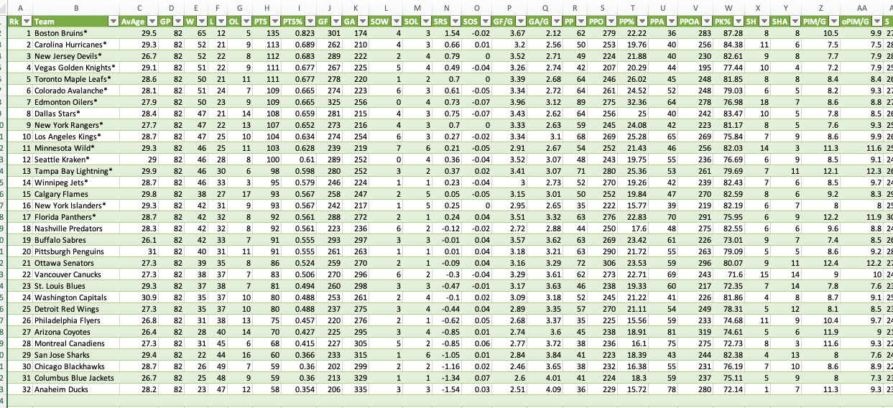
Think of some Questions to Answer!

